Slide 1

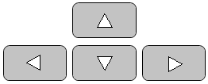
Excel for WINDOWS
Applied Statistics for Business and economics, 8e
David P. Doane and Lori E. Seward
In this tutorial, use your keyboard’s arrow keys to advance slides
or
Click on a topic below to jump to it
GETTING STARTED
Navigation
Excel Ribbons
EXCEL TOPICS
Basic Charts
Histograms
Scatter Plots
Descriptive Statistics
Pivot Tables
MegaStat*
Minitab*
*Optional

Slide 2

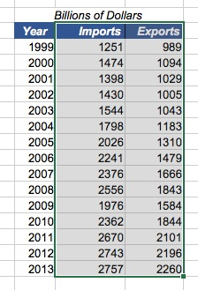

EXCEL NAVIgation
In a big worksheet, you may not be able to see it all. Use the touch pad, mouse, or arrow keys to move around the spreadsheet.
Three often-used key commands:
Ctrl-x Cut selection
Ctrl-c Copy selection
Ctrl-v Paste selection
Example: Copy a data range to a different location
Tip: Search the web to download a list of Windows keyboard shortcut commands.
Back to top menu

Slide 3

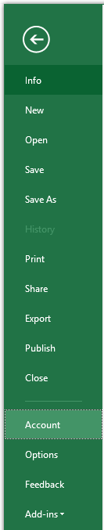
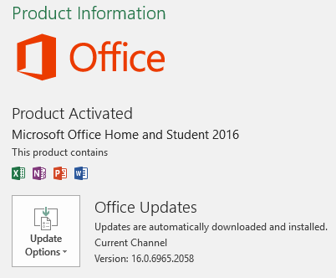
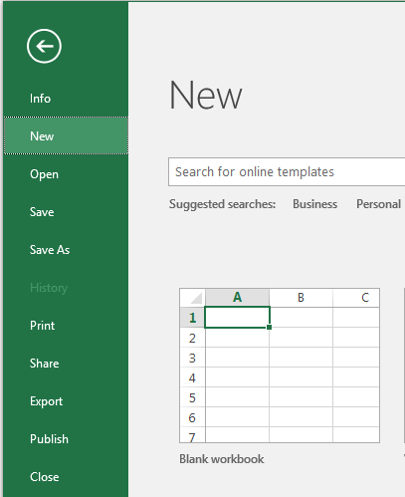
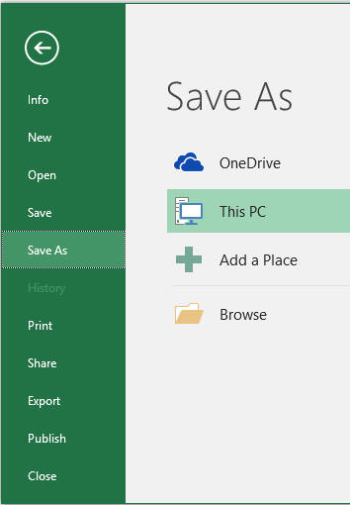
FILE RIBBON
Upper left corner of Excel ribbon
Click the file icon to save using current file name and location.
Choose Account to check your Excel version and license.
Open new file or browse for old file.
Choose your file name and location.
Tip: In long edits, periodically use Save As with a new file name (e.g., Sales-Version 03) in case you accidentally mess up the file.
Back to top menu

Slide 4
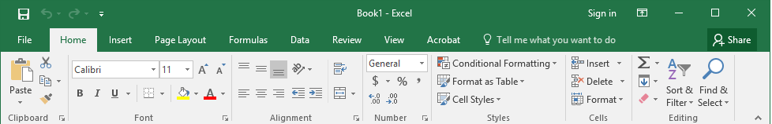
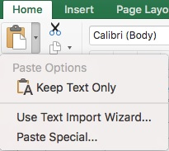
Ribbon TABS - HOME
Paste
When you click Paste you get Excel’s default format.
Cell Format
Displaying more decimals than are necessary is annoying. Poor decimal alignment makes it hard to read.
Sharing
Your team members can copy the shared workbook and add their data to the copy. Works best with Cloud storage, but tricky to use effectively.
Paste Special
Lets you choose a format that may be more suitable.
Poor
Better
Tip: The Home tab has so many useful features that you will use it often.
Back to top menu

Slide 5
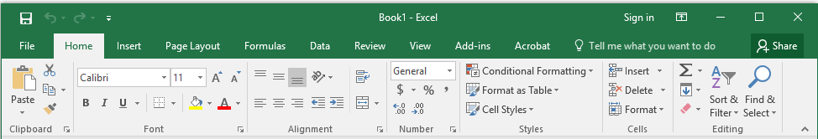
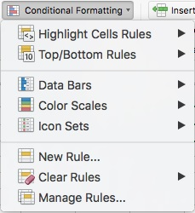
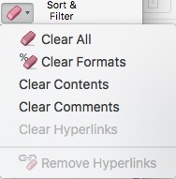
Ribbon TABS - Home
Fonts
Bold, italic, underline, background color, font color.
Text Alignment
Justify left, center, right, indent.
Number Format
Currency, percent, decimals, currency, or custom.
Conditional Formatting
Highlight cells in color based on the data value from a rule (e.g., >3) or built-in bars, colors, or icons. Useful to spot unusual values in a large data array.
Tip: Appearance is important in business. Make your spreadsheet look nice. You can never tell who is going to see your work.
Clear Remove formats as well as data in cells.
Back to top menu

Slide 6
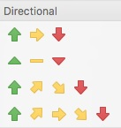
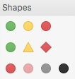

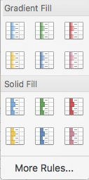
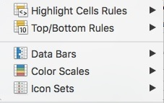
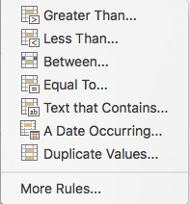
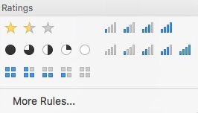
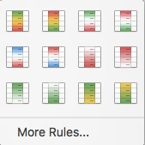
Ribbon TABS - HOME
Icon Sets
Data Bars
Color Scales
Conditional Formatting gives a quick impression of high/low data values.
Back to top menu

Slide 7
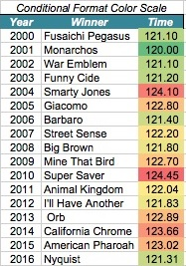
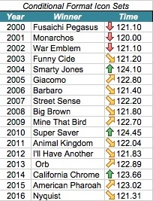
Ribbon TABS - HOME
Example: Kentucky Derby winning times 2000-2016 (17 years)
Highlight Cell Rules and Icons
Highlight Cell Rules and Icons
Tip: Colors are attractive, but may oversimplify data ranks.
Back to top menu

Slide 8
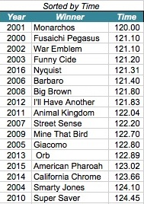
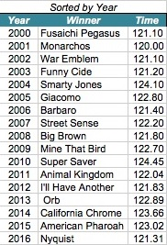
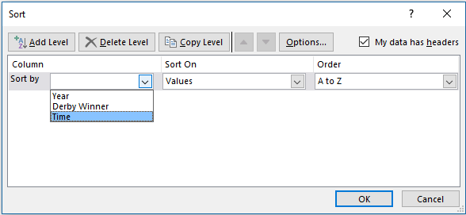
Ribbon TABS - HOME
Custom Sort
Example: Kentucky Derby winning times 2000-2016 (17 years)
Tip: sorting the data may tell you all you need to know.
Back to top menu

Slide 9
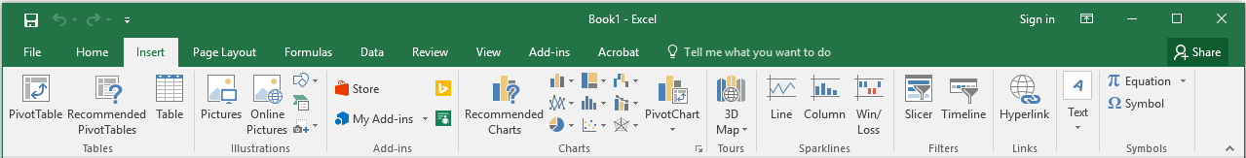
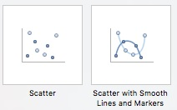
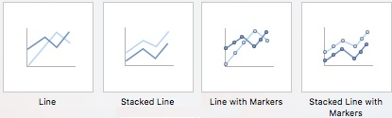
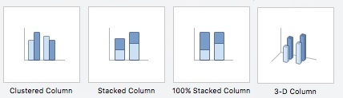

Ribbon TABS - insert
Pivot Table
Summarize and explore numerical data in a row-column cross-tabulation by category (see Tutorial 5 for details).
Example
Total and average square feet by subdivision and home type.
Charts
Scatter, line, and column charts are often used in data analysis. Less-used charts are not shown.
Note: These examples show only a few features of the Insert tab.
Back to top menu

Slide 10
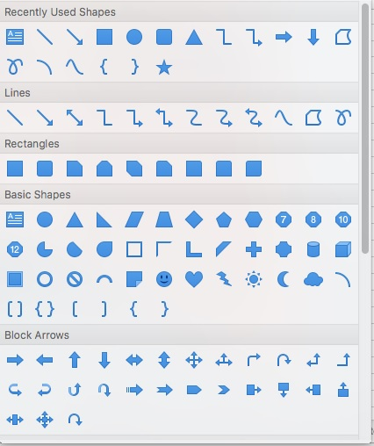
Ribbon TABS - insert
Shapes
Use arrows and shapes to point out items of interest. For example, these transparent rectangles with glowing edges.
Hyperlink
So reader can jump to a web site.
Text Box
Good alternative to typing in cells because you can drag it around.
Equations and Symbols
Sometimes useful in reports, but you can also use Symbol font to convert a b m s to α β μ σ.
Back to top menu

Slide 11
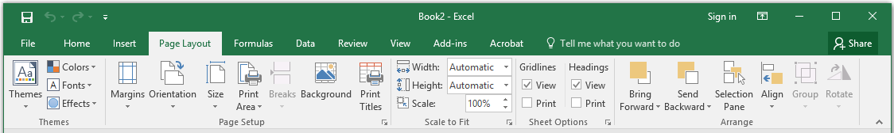
Ribbon TABS – page layout
Themes
Make your colors and layout more consistent. Or are you a do-it-your-selfer ?
Print Area
Save paper. Print only the portion of the worksheet that you actually need.
Gridlines
They make it easier to locate data values, but may be unattractive in a report. It’s your choice.
or
?
Back to top menu

Slide 12
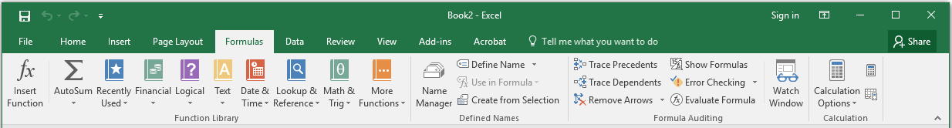
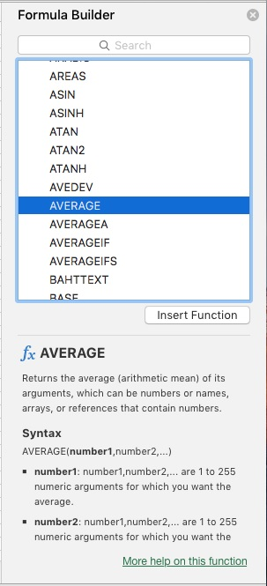
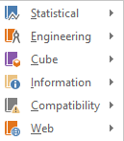
Ribbon TABS - formulas
More Functions
You can shorten the drop-down list of functions to Statistical.
Insert Function
Puts a function in a cell using this menu. After a while, you’ll learn the syntax of common statistics functions.
Back to top menu

Slide 13
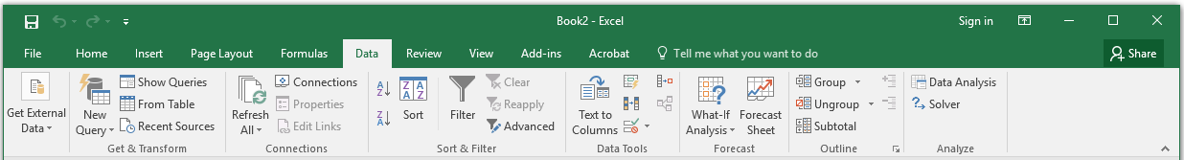
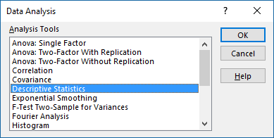
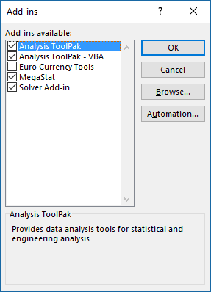

Ribbon TABS - data
Data Analysis
Instead of entering your own cell functions, you can do many kinds of analysis from a menu (see Tutorial 4).
The Data Analysis tools will not appear on the spreadsheet Data ribbon tab unless they were installed from File > Options > Add-ins > Go.
Back to top menu

Slide 14
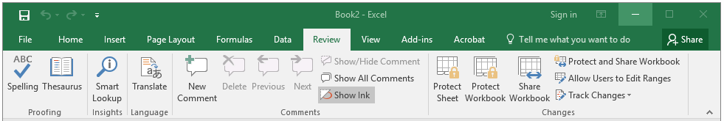
Ribbon TABS - review
Show All Comments
If you have annotated your cells with inserted comments (or if someone else has) you can see them all.
Protect Sheet
You probably won’t need this. Use it to prevent others from changing essential cells by accident.
Back to top menu

Slide 15
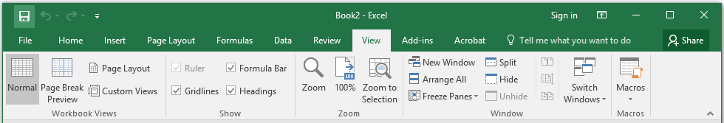
Ribbon TABS - view
Gridlines
Make it easier to locate data values, but may be unattractive in a report. Option is also on the Page Layout tab.
Formula Bar
Hide the formula bar. Most users like to see it.
Freeze Panes
Most often used to display column headings as you scroll down a long worksheet.
Macros
Advanced feature. Used to repeat a series of steps in a calculation.
or
?
Back to top menu

Slide 16
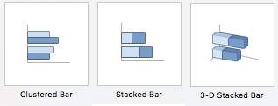
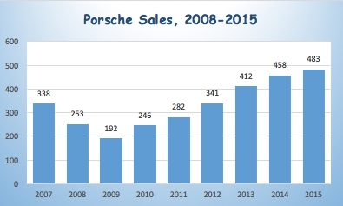
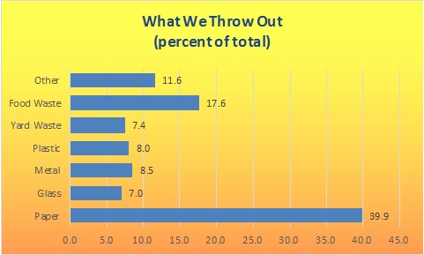
Tutorial 1 – Basic charts
COLUMN AND BAR CHARTS
Both charts display numerical data, either vertically (column chart) or horizontally (bar chart). Axis labels represent either a data attribute or time.
RECOMMENDATIONS
If the variable is a time series, put axis labels (e.g., years) on the horizontal X-axis with time increasing from left to right.
Height or length of each bar should be proportional to its data value. This is easy, since Excel defaults to a zero origin.
Add value labels at the top (or end) of each column (bar) except when labels would impair legibility.
Tip: This tutorial omits Excel charts that tend to distort the data, even though they might be visually appealing.
Back to top menu

Slide 17
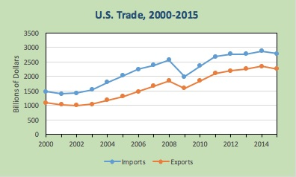
Tutorial 1 – Basic charts
LINE CHARTS
A line chart is used to reveal patterns and trends over time.
Tip: If your data only cover a few time periods, consider using a simple column chart with labeled data values.
REOMMENDATIONS
Use a line chart only for time series data y₁, y₂, …, y_{n} over n time periods.
Put the numerical variable(s) on the Y-axis and time on the X-axis with time increasing from left to right.
Except for log scales, use a zero origin on the Y-axis (this is the default in Excel).
Omit data labels if the data cover many time periods.
Use gridlines to help the reader see data values.
Data markers (squares, triangles, circles) are useful unless there are lots of data values.
Back to top menu

Slide 18
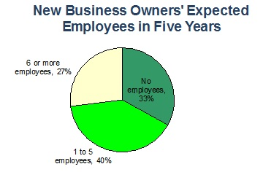
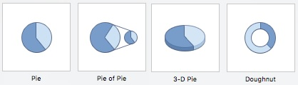
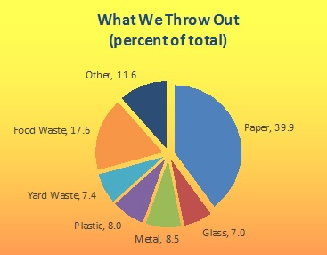
Tutorial 1 – Basic charts
PIE CHARTS
A pie chart is a circle divided into slices. Each slice’s area represents a percent or part of a whole.
RECOMMENDATIONS
Pie chart data must represent parts of a whole (e.g., percent market share).
Each slices should be labeled with its data value (or percent).
Pie charts can only convey a general idea of the data values.
Pie charts are ineffective when they have too many slices (typically 2 to 7). Exploded pie (right) may help.
Tip: 2-D pie charts are easier to interpret, but you may see 3-D charts in business because of their visual impact.
Back to top menu

Slide 19
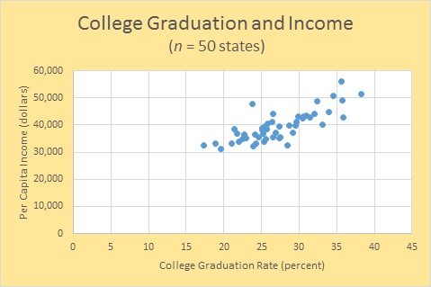
Tutorial 1 – Basic charts
SCATTER PLOT
A scatter plot is used to reveal relationships between two variables. It plots n pairs of observations (x₁, y₁), (x₂, y₂), . . . , (x_{n}, y_{n}) as dots (or some other symbol) on an X-Y graph.
Add title and axis labels, change plot area colors, format axis scales (e.g., decimals).
RECOMMENDATIONS
Select the (x, y) data (not column headings - you can add axis labels later). Click Insert and the Scatter icon.
The first column you select will go on the X-axis, but a scatter plot does not presume cause-and-effect.
Click on the chart to select it, The Format and Design ribbons will become active. Apply styles or edit chart features to improve clarity.
Alternatively, right-click on any chart feature (e.g., title, chart area, plot area, axis, data series). Explore edit options until you are satisfied with its appearance.
Back to top menu

Slide 20
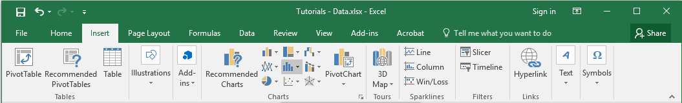
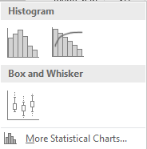
Tutorial 1 – Basic charts
STATISTICS CHARTS
The middle chart icon on the Insert ribbon offers two charts that are useful in a statistics class.
RECOMMENDATIONS
The Histogram is quick, though it has unattractive bin limits.
The Box and Whisker plot shows the range, quartiles, fences, and outliers. Refer to your statistics text for further explanation.
Back to top menu

Slide 21
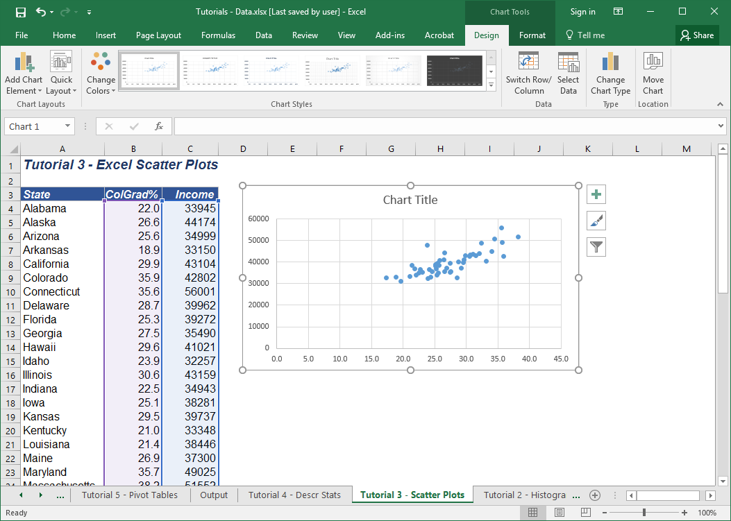
Tutorial 1 – Basic charts
EDITING A CHART
To customize a chart, click on it. Its border will change to show that it has been selected, and the Design and Format ribbons will become active. Edit the chart features using the drop-down menus.
Explore the Format and Design options and templates until you are satisfied with the graph’s appearance.
Back to top menu

Slide 22
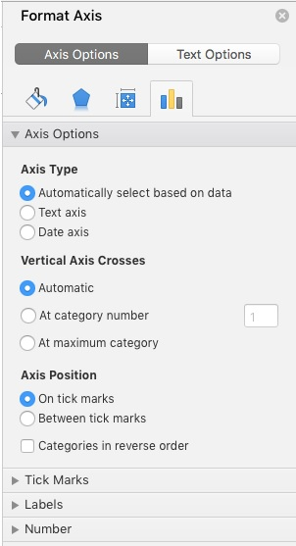
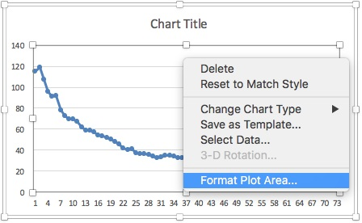

Tutorial 1 – Basic charts
EDITING A CHART
Instead of using the Format and Design ribbons, you can simply right-click on any feature of your graph (e.g., chart area, plot area, X-axis, Y-axis, chart type). For example, to improve the axis scale, right-click on the axis and choose Format Axis.
To add or change colors, click on the chart area or plot area. Explore the options until you are satisfied with the graph’s appearance.
Back to top menu

Slide 23


Tutorial 1 – Basic charts
TIME SERIES LABELS
On a line graph, Excel uses 1, 2, 3, … for the X-axis labels. To replace (e.g., with year labels) click on the graph and choose Select Data. Click in the white space by Horizontal (Category) axis labels and enter the cell range for the X-axis labels.
Tip: Without clear time axis labels, others won’t know what you are talking about.
Back to top menu

Slide 24


Tutorial 1 – Basic charts
TRENDLINE
If you wish to add a fitted trend to a line chart, right-click on the data series and choose Add Trendline. By default, the fitted trend will be linear. In this example, this fitted linear trend suggests that, on average, Porsche sales increased by 1099 units annually over this 15 year period.
By default, the fitted trend will be linear. While a linear trend is easy to interpret, it may not be the best choice.
After fitting the trend, you can click on the trend line and pick a different trend (or edit line color, style, and thickness).
You can extrapolate the trend, as shown here for two periods (but there is no guarantee the forecast will be credible).
There is an option to display the trend equation and its R² statistic (a measure of “fit” of the line).
If the displayed trend line equation is too small, you can enlarge its font (as was done here).
Back to top menu

Slide 25
Tutorial 2 - Histograms
HISTOGRAM
A histogram is a column chart whose Y-axis shows the number of data values (or a percentage) within each bin of a frequency distribution and whose X-axis ticks show the end points of each bin.
Example: caffeine content of n = 117 soft drinks. We examine the data and discover that its range is from 0.0 to 21.0. Our bins must cover this range.
Note: Excel puts its X-axis labels in the middle of each column, so they do not align with the bin limits.
HOW MANY BINS?
Sturges' Rule suggests that the ideal number of bins (k) for a histogram of n observations is:
k = 1 + log₂(n) or k = 1 + 3.3 log₁₀(n)
For n = 117 observations, Sturges' Rule suggests:
k = 1 + 3.3 log₁₀(117) = 1 + 3.3 (2.068) = 7.87 or 8 bins.
This is only a suggestion. Define any bins you wish to get “nice” bin limits.
Back to top menu

Slide 26
Tutorial 2 - histograms
THREE METHODS
There are three ways to make a histogram in Excel. The final result will look about the same after some editing.
Method | Pro | Con
Method A. Use the Insert tab to insert a so-called “statistics chart” with default bins. | Quick and easy | Weird bin limits. Requires editing.
Method B. Use the Data Analysis tool menu with bins that you define (or automatic bins). | Quick and easy. Allows user-defined bins. | Requires editing. Bin labels are centered instead of at cutpoints.
Method C. Make a bar chart using the =FREQUENCY array function with your bins. | Allows you full control. | Requires editing and array function =FREQUENCY(data range, bin range).
Method A
Method B or C (edited)
Back to top menu

Slide 27
Tutorial 2 - histograms
Step 1: Highlight the data range.
Step 2: From the Insert ribbon, click the middle chart icon and choose Histogram
METHOD A
Insert Chart
Comment: Method A gives a quick histogram, though its bin limits are weird and you can’t choose the bins.
Back to top menu

Slide 28



Tutorial 2 - histograms
Step 1: Examine the data and set up appropriate bins.
Step 2: From the Data ribbon, open the Data Analysis menu and choose Histogram.
Step 3: Enter the data range, bin range, and chart output location.
METHOD B
Data Analysis
Method A results
Note: Excel only looks at the upper bin limit.
Back to top menu

Slide 29

Tutorial 2 - histograms
METHOD C
Do-It-Yourself
Step 1: Create “nice” bins that cover the range (only the upper bin limits are used).
Step 2. Create a blank column for frequencies.
Step 3. Highlight the empty frequency cells and type the array function in the edit window. Its syntax is =FREQUENCY(data range, bin range). Then simultaneously press Ctrl-Shift-Enter.
Step 4. Highlight the frequencies and insert a column chart.
Step 5. Edit the chart, e.g., widen the bars and reduce gap width.
Note: An array function has squiggly brackets { }. Its range cells cannot be edited except as a whole.
Back to top menu

Slide 30

Tutorial 3 – scatter plots
Step 1: Click on the Insert tab.
Step 2. Highlight the two data columns. The first column is X (horizontal axis) and the second column is Y (vertical axis). Don’t include the column headings – you can add axis titles later.
Step 3. Click on the Scatter icon. A simple scatter plot is usually best.
Step 4. Edit the scatter plot to improve its appearance (axis labels, title, fonts, colors, etc).
Back to top menu

Slide 31
Tutorial 3 – scatter plots
Excel Default Scatter Plot
CUSTOMIZE THE CHART
A graph’s appearance is important in business. Here are some ideas to improve almost any Excel default chart, as illustrated here for a scatter plot.
Add clear titles (chart, x-axis, y-axis).
Improve the axis scales (min, max, ticks).
Change color or patterns in the plot area or chart area.
Format decimals to make axis scales more readable.
Improve markers and lines (size, color).
Change scale origin if necessary for clarity.
Add a trend line on a scatter plot.
Adjust font sizes for readability.
Customized Scatter Plot
Note: If you add a fitted regression (which Excel calls a “trend”) you suggest cause-and-effect. Do higher college graduation rates cause higher per capita income in a state?
No title, no axis labels, poor format on axis numbers.
Back to top menu

Slide 32

Tutorial 3 – scatter plots
To add a trend line:
Step 1: Click on the dots in your scatter plot.
Step 2. Right-click and choose Add Trendline. The default is Linear.
Step 3. Click options to display the equation and R² of the fitted line.
Back to top menu

Slide 33
Tutorial 3 – scatter plots
Excel default trend
SUGGESTIONS
Add a title and axis labels.
Move the trend equation text box to a better location and increase its font size for readability.
Click on the trendline. Change its color, style, and width.
Right-click on the X-axis and adjust the scale decimals (on the Number menu).
Right-click on the Y-axis and use comma format (on the Number menu).
Customized chart
Back to top menu

Slide 34
Tutorial 3 – scatter plots
MORE OPTIONS
Click on the X or Y axis to adjust the origin (X_{min} , Y_{min}) if you think that more detail is needed.
The trendline does not have to be linear. You can click on it and choose a different functional form.
Click the Chart Area or Plot Area to try different colors, or try styles from the Design ribbon.
Option: The default origin (0, 0) is conservative, but “wastes” much of the graph. Should we change the origin, say to (15, 20000) to reveal more detail?
Note: A non-linear trend may give a better fit, but may be harder to interpret.
Option: Regression treats X as the independent variable, suggesting that each extra percent in college graduation is associated with $919 of extra per capita income. Is that reasonable?
Back to top menu

Slide 35


Tutorial 3 – SCATTEr PLOTS
From the Data ribbon, choose Data Analysis and Regression.
Note: The Regression option gives you R² and estimated coefficients, but also includes tests of significance.
Note: The scatter plot trendline shows only the circled statistics.
Back to top menu

Slide 36




Tutorial 4 – DATA ANALYSIS
Do It Yourself Method
From the Formulas ribbon, you can insert a function in a cell to find various statistics, such as the X-Y correlation coefficient.
Option 1: Use Insert Function to set up the function in a cell.
Option 2: Use the More Functions menu and choose Statistical functions to find the one you want.
Back to top menu

Slide 37



Tutorial 4 –Descriptive statistics
Data Analysis Tools
From the Data ribbon, you can get common descriptive statistics without entering your own cell formulas.
Note: A disadvantage of using the convenient Data Analysis menu is that you can’t choose the statistics.
Back to top menu

Slide 38


Tutorial 5 – pivot tables
PIVOT TABLE STEPS 1-3
On the Insert tab, click PivotTable. In the worksheet, your data should be surrounded by a dashed line. If it isn't, click and drag to select your data.
When you do this, the Table/Range box will automatically fill with your selected cell range.
Choose where to place the pivot table. If you choose Existing worksheet, specify the upper left corner of the pivot table table’s desired location typing a cell reference (by clicking in a cell).
Back to top menu

Slide 39


Tutorial 5 – pivot tables
PIVOT TABLE STEPS 4-6
On the Pivot Table/Analyze ribbon tab, click on Field Settings
In the FIELD NAME area, check the boxes for fields that you will display.
Drag the fields to the desired location in the pivot table. In the Values area, choose the numeric field that is the focus of your analysis. Choose non-numeric fields (categories, labels, or dates) for the Rows or Columns.
Back to top menu

Slide 40



Tutorial 5 – pivot tables
OPTIONS
Once you have created the pivot table, you can edit it (e.g., column width, decimals) for improved readability.
You can make a copy of the table in another location. Highlight the entire table, and use copy-paste. This is useful if you want to edit the Value field without changing the original table.
To change the Value field, click on Field Settings in the Pivot Table Analyze ribbon tab. For example, you can display the mean (Average) or the number of data items (Count) in each cell.
Original pivot table displaying total square feet of all homes by category
Copy of pivot table displaying average square feet of homes by category
Back to top menu

Slide 41

Tutorial 6 – Megastat
MegaStat is an Excel add-in with easy-to-use menus for statistical analysis on Mac or PC. Download it from McGraw-Hill’s Connect website*.
INSTALLING
Step 1: Click the installation workbook MegaStat Add-In Installer.xlsm. The two files MegaStat.xlam and MegaStat.chm must be in the same folder as the installation workbook.
* It costs about $15.
Step 2: When you open the installation workbook there will be an Install MegaStat button. Click it and the MegaStat files will be copied to the Add-ins folder and MegaStat will be placed on the Add-ins ribbon. When you open the installer workbook you may be asked to click Enable Content.
You need to enable macros in Excel to install and run MegaStat.
Back to top menu

Slide 42


Tutorial 6 – Megastat
Example: We want to analyze caffeine content of 117 soft drinks.
Step 1: Click on the Excel Add-ins ribbon. MegaStat will appear in the upper left of the screen.
Step 2: Click on Descriptive Statistics.
Back to top menu

Slide 43

Tutorial 6 – Megastat
Step 3: Select the descriptive statistics that you want.
Tip: To select your data, click in the Input range box and then double-click anywhere in your data column.
Example: Descriptive statistics for caffeine in n = 117 soft drinks.
Back to top menu

Slide 44

Tutorial 6 – Megastat
Results: Descriptive statistics for caffeine in 117 soft drinks
Output: Results will appear on a new worksheet tab. You can copy or edit the graphs with the usual Excel chart edit tools.
Back to top menu

Slide 45


Tutorial 6 – Megastat
Example: Regression using income and college graduation rates for n = 50 states. Choose the plots and tables that you want.
Back to top menu

Slide 46

Tutorial 6 – Megastat
Results: Regression using income and college graduation rates for n = 50 states.
Significant results are highlighted.
Output: Results will appear on a new worksheet tab. You can copy or edit the graphs with the usual Excel chart edit tools.
Unusual residuals or high-leverage observations are highlighted.
Back to top menu

Slide 47

Tutorial 7 – Minitab
Menu Bar (with drop-down commands)
Minitab is a statistical analysis system for Mac or PC. It is not based on Excel.
Session Window (just plain text that you can copy to your report or spreadsheet)
You can import Excel data to Minitab and export its graphs and other results.
Worksheet (like an Excel spreadsheet)
Back to top menu

Slide 48

Tutorial 7 – Minitab
To import data from Excel, just highlight the data range and copy it (Ctrl-C).
Note: If your spreadsheet uses $ format or commas (e.g., $47,352) you must reformat to plain numbers (e.g., 47352) or else MINITAB will treat the data as text.
Back to top menu

Slide 49

Tutorial 7 – Minitab
This is the menu you will use most often (for descriptive statistics).
The –T suffix (e.g., C2-T) designates a text column (non-numerical data ).
Back to top menu

Slide 50

Tutorial 7 – Minitab
Quick statistics are the beginning point for many projects.
Back to top menu

Slide 51



Tutorial 7 – Minitab
Text columns will not be listed as variables because they are non-numerical.
Highlight the variable s) you want and click Select.
Click Statistics or Graphs to get these sub-menus, and then select the options you want.
Back to top menu

Slide 52

Tutorial 7 – Minitab
You can store the various statistics in the worksheet.
Tip: You can save your results in the worksheet (or you may prefer to copy and paste them into Excel).
Back to top menu

Slide 53



Tutorial 7 – Minitab
Choose the statistics you want to display. The session window shows the results. You can copy and paste them into Word or Excel.
Each graph appears in a separate window. Double click any graph to edit it.
Back to top menu

Slide 54

Tutorial 7 – Minitab
Tip: The session window shows your descriptive statistics. You can copy them as text or as a PNG to paste it into Word or Excel.
Interpretation: The mean and median are almost the same for winning U.S. Open Golf scores for men (n = 75 years). However, the skewness and kurtosis statistics suggest possible asymmetry and leptokurtic distribution. Possible outlier(s)?
Back to top menu

Slide 55

Tutorial 7 – Minitab
Tip: When you double-click on a graph feature (e.g., X-axis), edit tools appear so you can choose options, add text, draw lines or shapes, change fonts, or edit colors.
Tip: Each graph is in a separate window. Double click a graph to edit it. You can copy as a PNG to paste into Word or Excel.
Interpretation: The distribution appears somewhat bell-shaped except for a high concentration near 280 and an unusual value in the right tail.
Back to top menu

Slide 56

Tutorial 7 – Minitab
Tip: Graphs are a communication device. You may want to improve axis labeling, edit graph titles, or add annotations to suit your audience. Minitab graphs can be edited to match the colors or fonts of your PowerPoint presentation.
Before
After
This is just to show what can be done, not to suggest that this is an improvement.
Back to top menu

Slide 57
Tutorial 7 – Minitab
There are many choices for copying a graph.
Back to top menu

Slide 58





Tutorial 7 – Minitab
Here are some examples of descriptive Minitab graphs using U.S. Open winning golf scores, 1947-2021.
Back to top menu

Slide 59



Tutorial 7 – Minitab
Tip: You can set the time scale labels and edit graph labels. Do you see a trend toward improving scores over time?
Back to top menu

Slide 60

Tutorial 7 – Minitab
Except for a few unusual tail values, this plot of winning golf scores resembles a normal. Its p-value (.298) would not lead us to reject normality at the usual significance levels (e.g., α = .05).
A small p-value (near 0) or a non-linear probability plot would suggest non-normality.
Back to top menu

Slide 61

Tutorial 7 – Minitab
MINITAB’s Graphical Summary has key plots (histogram, box plot, confidence intervals) and common statistics (mean, standard deviation, quartiles, p-value for normality test). Do you really need anything more?
Back to top menu

Slide 62

Tutorial 7 – Minitab
Where’s My Graph?
Don’t panic. The Navigator pane shows a list of all the graphs and results that you have created.
Back to top menu

